Slide 1
SVM
Kozy-Korpesh Tolep

Slide 2
Method-driven project
Motivations
Description of the method
Discussion of the assessment on synthetic data

Slide 3
Motivation
Senior project in BSc
“A Machine Learning Model Selection considering Tradeoffs between Accuracy and Interpretability”
Interest in SVM

Slide 4
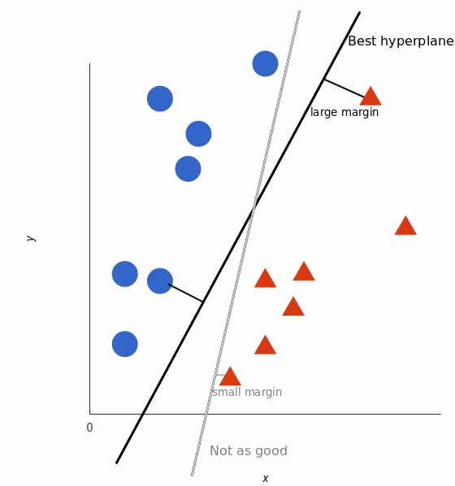
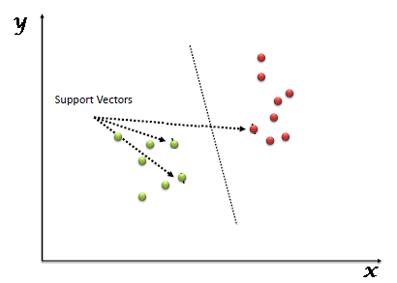
Description of the method

Slide 5
How it choses optimal hyperplane?
Thumb rule: find hyperplanes that segregates two classes better.
Amongst those choose which has the maximum distance, margin from nearest data points
Assumption of the SVM: hyperplane which separates the points and also far away from training data as it can be, will generalize best unseen data.

Slide 6

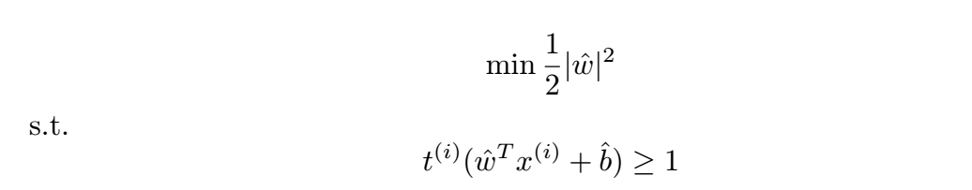
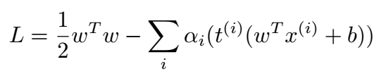
Mini-max problem, Lagrange multipliers

Slide 7
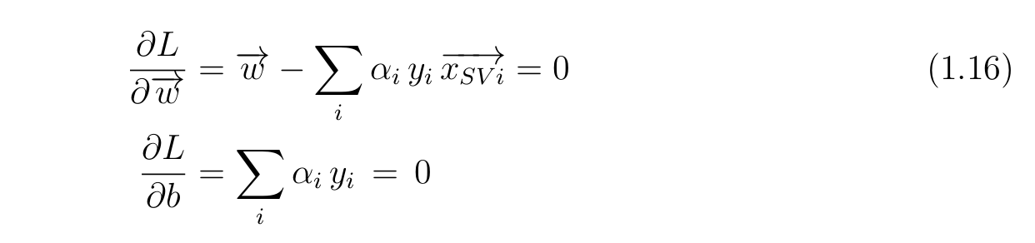
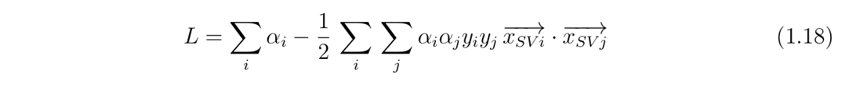
The result above is very important because we figured out that the normal vector (w) are linear combination of the support vectors.
Finally, we have find out that maximization depends on the dot product of pairs of support vectors.

Slide 8
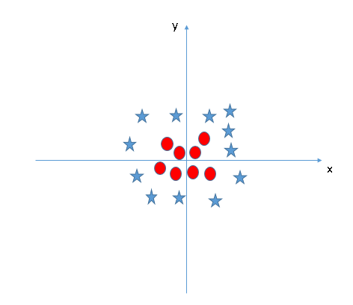
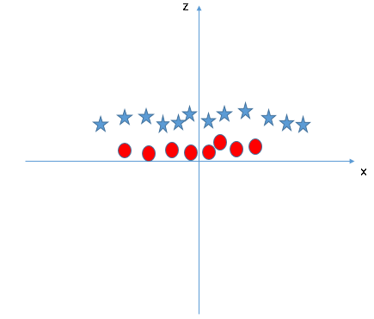
Non-linear seperation problem
SVM uses technique called **kernel trick** which converts low dimensional input to higher dimensional space

Slide 9
Kernels
1. Polynomial kernel. More generalized form of the linear kernel.
Formula: (X1, X2) = (a + X1^T * X2) ^ d, where d is the degree of polynomial space.
2. Radial Basis Function Kernel. Popular kernel function used in classification tasks, it can map input space to infinite dimensional space.
Formula: f(X1, X2) = exp(-gamma * ||X1 - X2||^2), where gamma is value bet

Slide 10
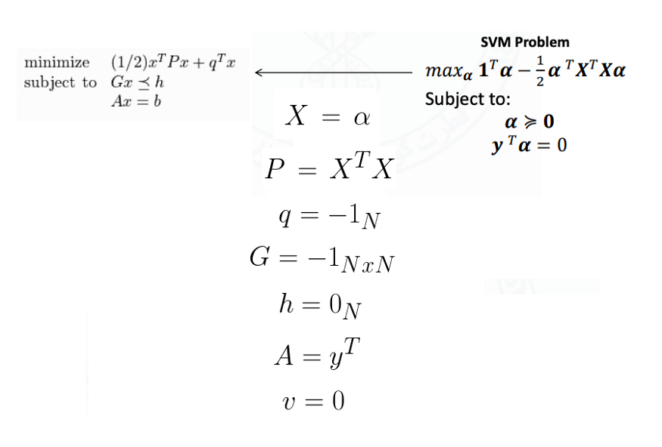
Next, to solve Lagrangian multiplication we need to use CVXOPT library and express equation in terms of matrices not summations. So we need to convert our multiplication to

Slide 11
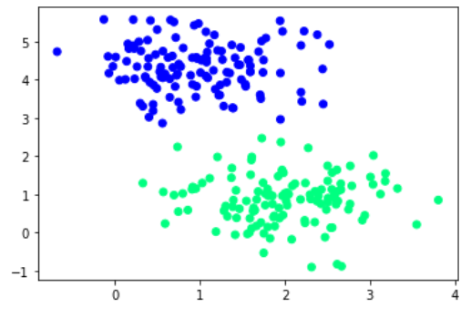
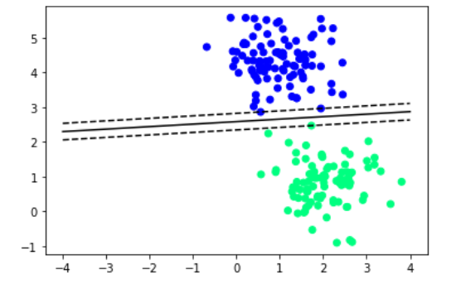
Results

